Slide 1
CS 4530: Fundamentals of Software Engineering Module 2.1: Requirements Analysis
Adeel Bhutta, Rob Simmons, and Mitch Wand
Khoury College of Computer Sciences
© 2026 Released under the CC BY-SA license

Slide 2
Learning Goals for this Lesson
At the end of this lesson, you should be prepared to
Explain the overall purposes of requirements analysis
Recall the three major dimensions of risk in requirements analysis
Explain the connection between requirements analysis and user stories
Notes:
<read slide>

Slide 3




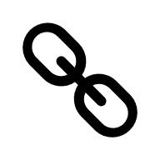


The big picture
PEOPLE
PROCESSES
PROGRAMS
PLANNING
user stories
ORGANIZING
and
conditions of satisfaction
implementing
Notes:
This lecture is providing part of the bigger picture for the context of user stories in software engineering. Connecting user stories with conditions of satisfaction is how we organize our software engineering process — that’s central to what we’re doing in this class.
This lesson talks about how we decide what user stories to select as part of our planning. Our course staff will judge whether your essential conditions of satisfaction represent an MVP for your user story. But they mostly won’t be judging whether your user stories are user stories worth doing.
In other words, in the context of this cass we mostly see it it as a technical decision about how to satisfy a user story — a complex technical decision that involves design, but a technical decision.
But in reality, who decides what actual software should get built, what user stories should get prioritized? How do they decide?
DISCUSS: Who do you think gets to decide what user stories actually get prioritized in practice?

Slide 4
Requirements Analysis connects High-Level Planning To User Stories
PEOPLE
PROCESSES
PROGRAMS
PLANNING
Requirements Analysis
User Stories
Testing Conditions of Satisfaction
ORGANIZING
implementing
Notes:
Connecting the actual needs of people to user stories is the role of requirements analysis. We’ll discuss Value Sensitive Design specifically, and provide a pointer to more information in course materials.
In the context of requirements analysis, user stories to help us understand and communicate what we’re planning to do — the output of requirements analysis is often a prioritization of user stories. In your project, you’ll propose more than three user stories but then only be responsible for implementing three. You’ll be able to use whatever methodology you want for prioritizing user stories, but that’s not usually the case in the real world!

Slide 5
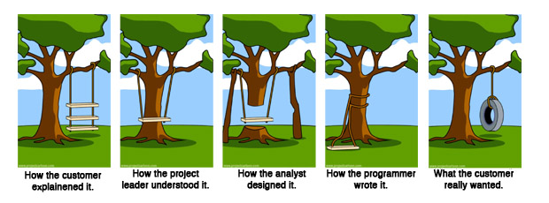
Overall question: How to make sure we are building the right thing
https://en.wikipedia.org/wiki/Tree_swing_cartoon
Notes:
Remember: the overall question for Requirements Analysis is making sure that we are building the right thing.
This meme does a great job capturing the many ways in which we can get off course and end up building the wrong thing. It may not be surprising that this meme dates back to at least the 1970’s, and long before the internet, was photocopied and hung up on the wall in many offices, particularly at software companies. These are not new problems: understanding what the customer wants the software to be, and then ensuring that we implement something that solves that problem is not easy.

Slide 6
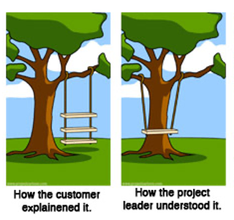
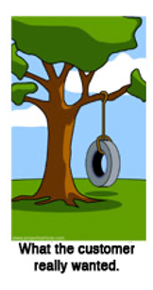
Why is requirements analysis hard?
Problems of understanding
Do users know what they want?
Do users know what we don’t know?
Do we know who are users even are?
Problems of scope
What are we building?
What non-functional quality attributes are included?
Problems of volatility
Changing requirements over time
6
Notes:
While getting the right requirements can certainly help make sure we build the right thing, it definitely doesn’t guarantee it.
Consider right now an example developing of a virtual meeting platform. With the start of the COVID-19 pandemic, and shift to virtual meetings, there has been an enormous demand for software to help substitute for physical events. But, even today, many platforms still don’t provide the experience that users want: how do you replace some physical interactions with a software product? These kind of challenges come up all of the time in software projects.
Sometimes, clients want to bring software in to solve some problem that is currently not being addressed, but don’t know exactly how to solve it. In other times, new software is brought in as a technology to improve an existing process. There is a way that things are done, and your software is going to help that get done better. In those situations, the client may simply not know what will work best for them.
Software engineering aims to provide answers, or at least a framework for answers to these questions
<Read slide. Possible elaboration:>
Examples of problems of understanding corresponding to the bullets:
What they want? -> Simply don’t know what is possible, won’t know it until they see it, often know what the problem is that they want the software to solve, but not the solution. Coming up with the solution is a design problem. Good to have a buddy who is a user experience designer.
What we don’t know? -> Most software is not “general purpose”, but exists within some domain.
Who are our users? -> Maybe most common in startups, where you have a client (moneybags investors) who are guessing who your users will be and what they want
Scope - What are we building? -> How to agree with client on a statement of work that is feasible given constraints, how to make sure that we stay on track?
Scope – quality attributes -> How to specify things like performance, usability, maintainability, security, etc
Volatility -> Long projects are subject to changes in world around them

Slide 7
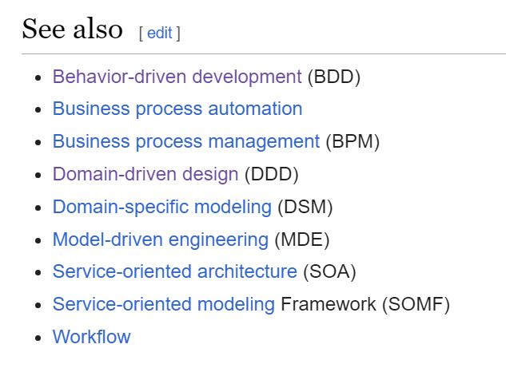
How do we capture the requirements?
There are many frameworks for capturing requirements.
Often described as x-Driven Design (for some x)
They differ in scope & details, but they have many features in common.
Notes:
In this lesson, we'll primarily be concerned with problems of understanding. How do we get from a customer's vague notions of what they might want to something concrete enough to guide us to build it.
<read slide>

Slide 8
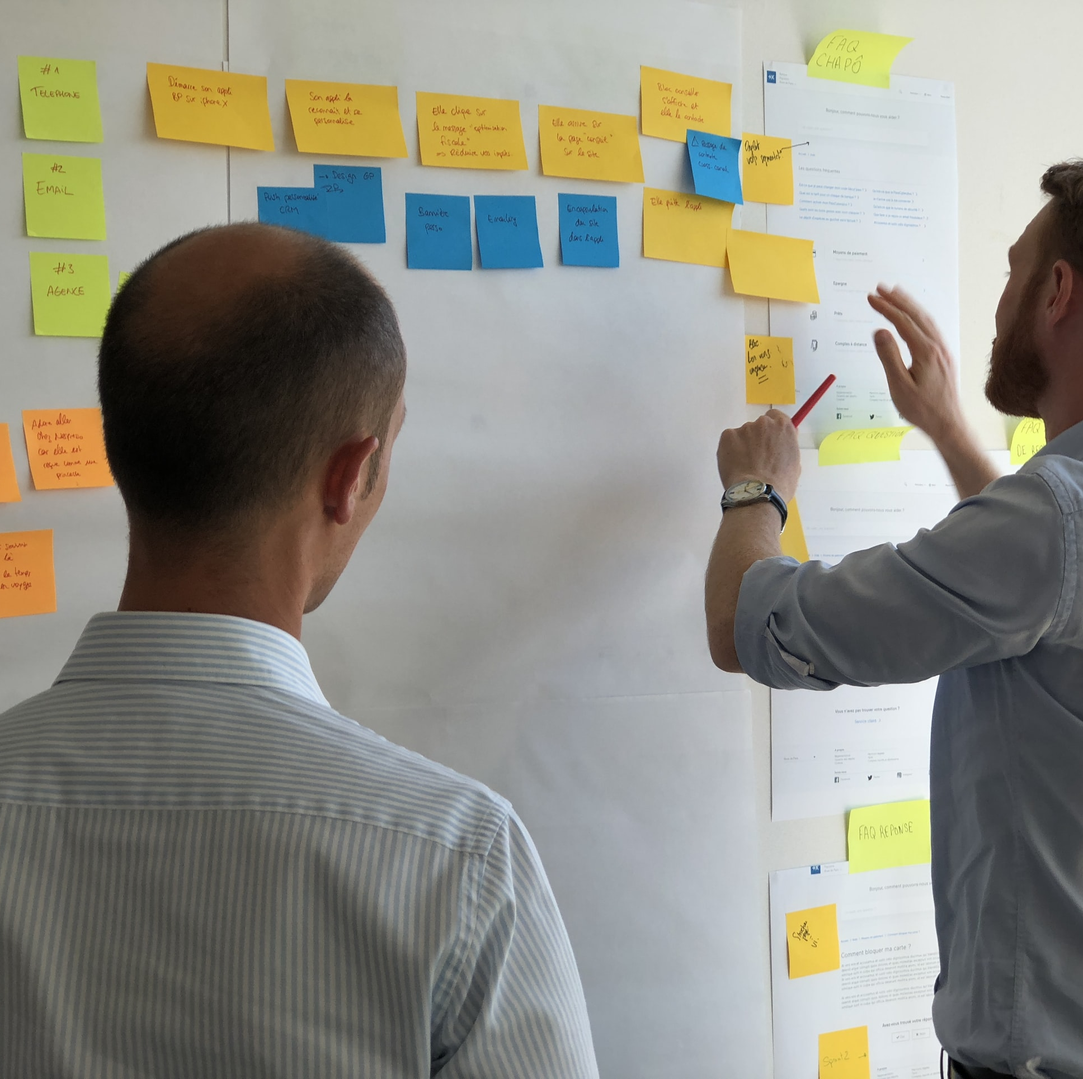
Common Elements
Meet with stakeholders
Develop a common language
Collect desired system behaviors that offer value
Document the desired behaviors
Iterate and refine!!
User stories are the least common denominator of most approaches
Notes:
Here are some things that these different methods have in common. Notice two important things: stakeholders and value <read slide>
The artifact produced by these common elements is user stories!

Slide 9
“Building the Right Thing” Necessarily involves Value Judgments
Right for whom?
Who benefits?
Limitations of budget/time/personnel
Competing/incompatible ideas about what's important
Competing/incompatible sets of COSs

Slide 10
Requirements Gathering includes Prioritizing User Stories
The last lecture covered prioritizing conditions of satisfaction within a user story.
Now we’re talking about prioritizing user stories. This is a complex planning activity that is constrained by resources (budget, time, personnel) and multiple (competing or incompatible) ideas about what’s important.
Notes:
.

Slide 11
Requirements Gathering Example: Value Sensitive Design
Value Sensitive Design (VSD) is one framework (of many!) for doing requirements gathering
VSD guides designers and engineers to pay special attention to stakeholders and human values when writing and prioritizing user stories
Combines empirical, value, and technical
https://vsd.ccs.neu.edu/introduction/what-is-vsd/
Notes:
The process of VSD includes three kinds of investigations:
Empirical: This is about understanding how the value works in real life based on observations made in the field or from life experiences.
Value: Involves identifying stakeholders, thinking about their goals and values and then finally resolving the value tensions arising from conflicting interests of stakeholders.
Technical: The technical feasibility of implementing the solutions.

Slide 12
VSD Example – Informed Consent
Empirical Investigation:
Understand what we mean by informed consent, encompasses:
Disclosure. Do we know the pros and cons of taking an action?
Comprehension. Do we understand the disclosures?
Voluntariness. Is there coercion or manipulation?
Agreement. Is there a clear opportunity to consent or not?
Competence. Are we capable to give consent?
Values Investigation:
Who are the direct and indirect stakeholders?
Do the stakeholders have conflicting values?
How can we resolve them?
Technical Investigation:
What are the technical mechanisms for implementing informed consent.
One way => cookie consent management system.
Websites use them to obtain and manage user permission for using cookies.
Notes:
The slide illustrates how to use VSD to think about a value like informed consent:
Do an empirical investigation which involves understanding the meaning of the value. In this case understanding informed consent hinges on four concepts as outlined. Often to understand a value one will have to collaborate with experts in a field such as sociologists, philosophers, domain experts.
Identify the stakeholders and value tensions. For e.g., the stakeholders here could be site users and site owners. Their interests may align or conflict. For e.g., site users may want to be anonymous, but site owners might want to monetize site usage by sharing personal usage data with advertisers. On the other hand, they may align if the site owners want to make accountability and transparently a core value of their operations.
Cookies in browsers are one way to collect personal information after taking permission from the users.

Slide 13
Review: Requirements analysis
How do we make sure we are building the right thing?
How do we learn from potential users before we start?
Values: what even makes something the “right thing”
Most forms of x-Driven Design could be a whole course on their own
Notes:
You’re not going to be experts on requirements analysis after this lecture, or on Value-Sensitive Design. Any form of x-Driven Design could be the focus of a whole class.
From our perspective, requirements analysis is where the user stories we focus on come from in the first place, but in this class you’ll mostly be making up user stories based on an imagined idea of what an imagined user might want. That is… unfortunately how things often work in the real world, and a staggering amount of resources have been wasted as a result. (Some would blame Meta/Facebook’s VR projects of failing at this level.)
If you’re actually starting any kind of software engineering project in the real world, seriously studying x-Driven Design for almost any value of x and using it to organize and prioritize your user stories, or partnering with people that have more than a 30-minute lecture’s worth of experience in the idea, is something you should take seriously.

